Slide 1
Setup
Getting through the boring stuff with confidence
Notes:
In this first day, we are going to focus on getting through all the hardware setup and testing so that we can spend the remainder of the course on writing code. This might sound a little less exciting than coding, but that doesn’t mean it’s not extremely valuable. In many cases, not wanting to navigate this step of the project unsupported is what prevents people from being able do these kinds of projects. If you’re new to programming or working with Raspberry Pi, there are a lot of exciting things to see today.

Slide 2

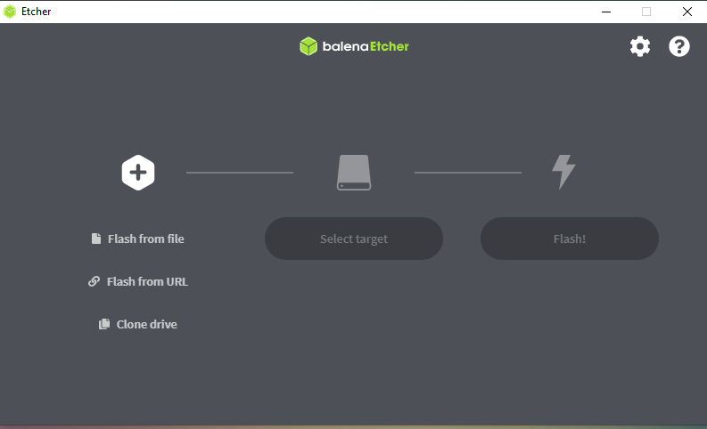
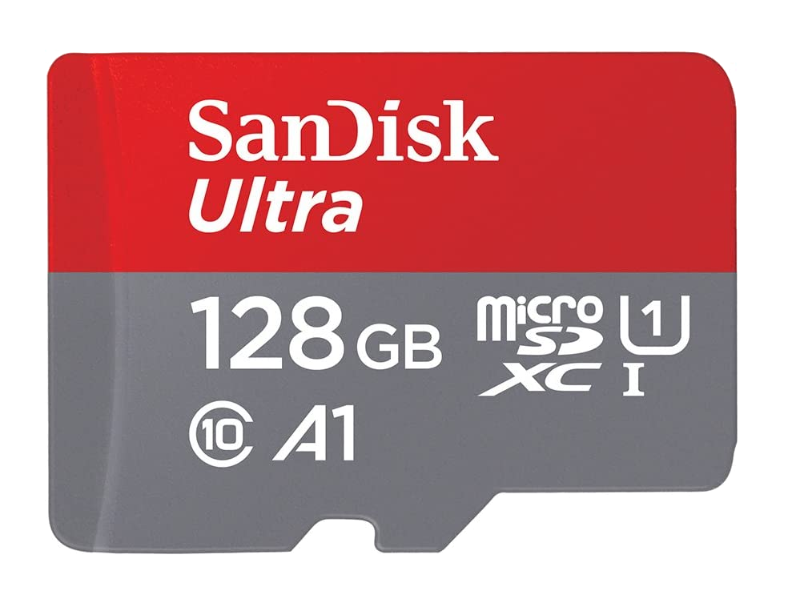
Image Raspberry Pi SD Card
The first step of doing any development using the Raspberry Pi is to load the operating system onto the SD card which the Raspberry Pi uses as a hard drive.
The OS is known as Raspbian, and can be downloaded for free from the Raspberry Pi Foundation website. https://www.raspberrypi.com/software/operating-systems/
We use a program called Balena Etcher to write this OS image onto the SD card so that we can boot the Raspberry Pi.
Notes:
Pre-written SD cards should be given to students, with an invitation to come walk through the process of writing one and learning the process to make cards for the next class as they have downtime.

Slide 3
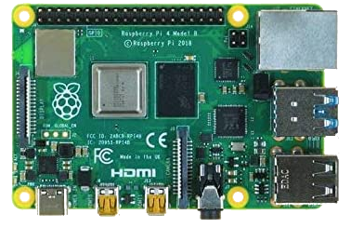
Connect SD Card, Screen, Mouse, Keyboard and Power
2- Insert Mouse and Keyboard USB
1 - Insert micro SD Card (back side)
4- Connect USB-C for Power
3 - Connect Mini-HDMI cable for Monitor
Notes:
It doesn't matter which USB ports you select for the mouse and keyboard It doesn’t matter which HDMI port you select for the monitor The USB-C for power should be connected last to make sure everything is connected before you boot the Raspberry Pi.

Slide 4
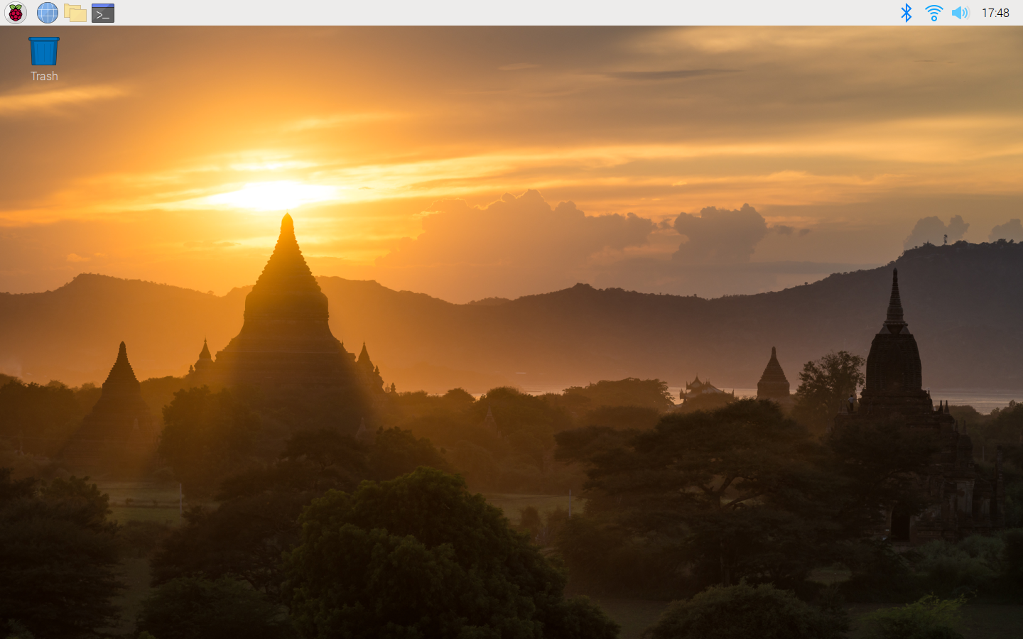
Introduction to Raspbian OS
Notes:
It’s a full blown graphical OS, like Windows or Mac, with a web browser and other programs
Click the icons show above to open the File Explorer and Terminal programs

Slide 5
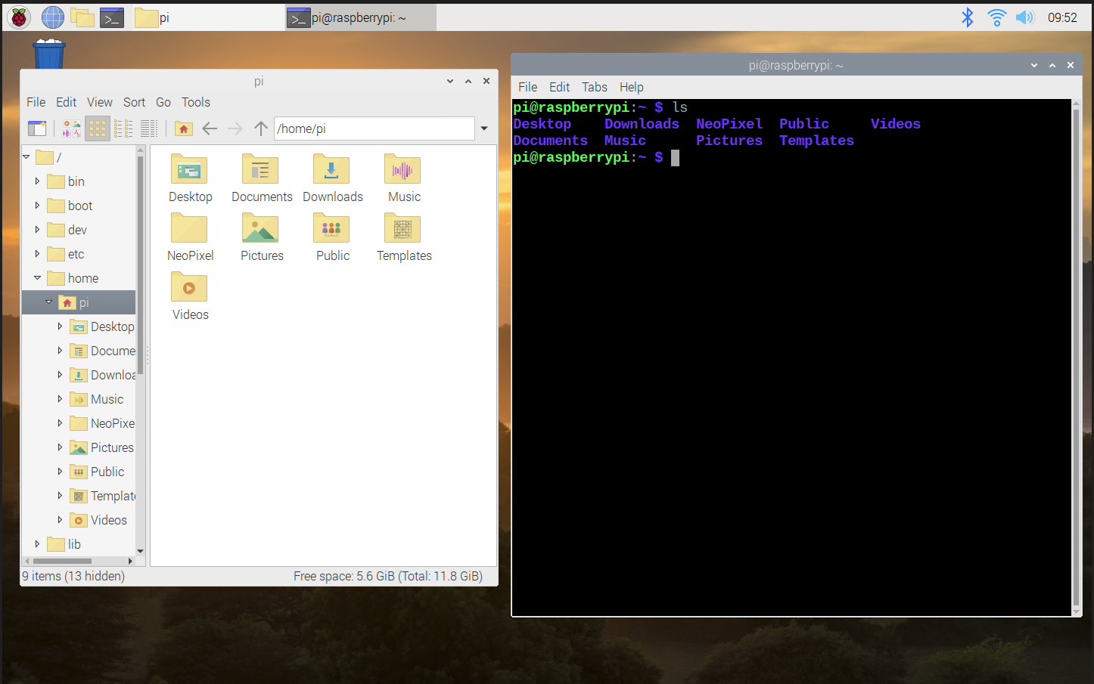
Using the File Explorer and the Terminal
Notes:
Modify the screens so they look like these, with one on each side. You are likely familiar with the file explorer you see on the left. It’s a graphical user interface like every computer uses nowadays. The screen on the right is the terminal window. It’s what we’ll be using in this course, because it’s what hackers use and we’re going to be awesome like that.

Slide 6
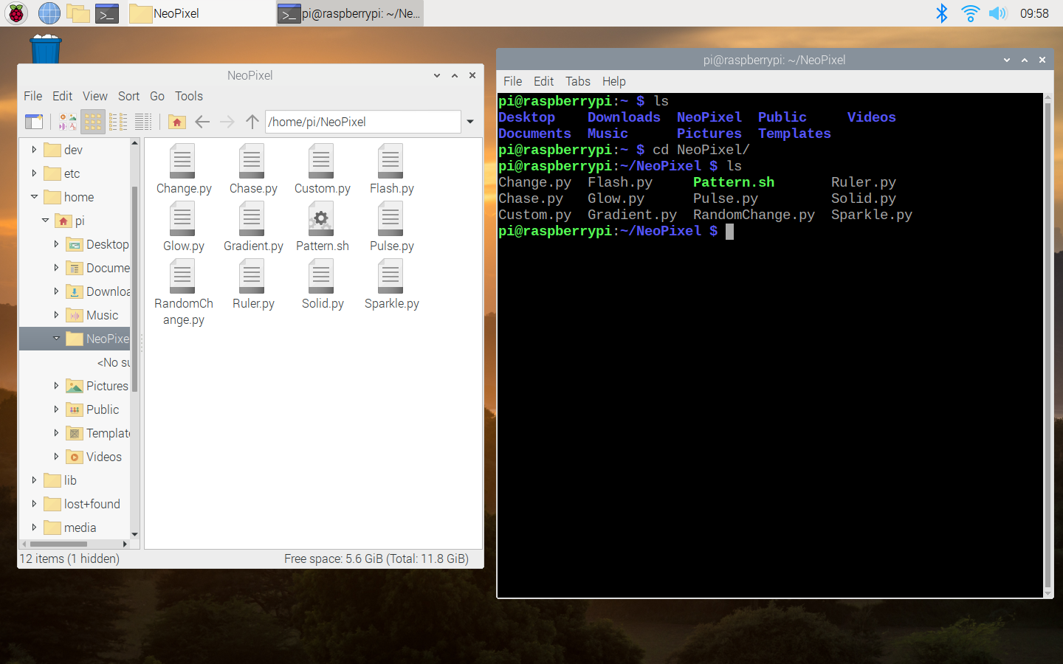
Changing Directories
Notes:
In the file explorer, click into the NeoPixel folder. In the terminal window, type cd NeoPixel and then type ls again. Note that these are two different ways of viewing the same file directory.

Slide 7
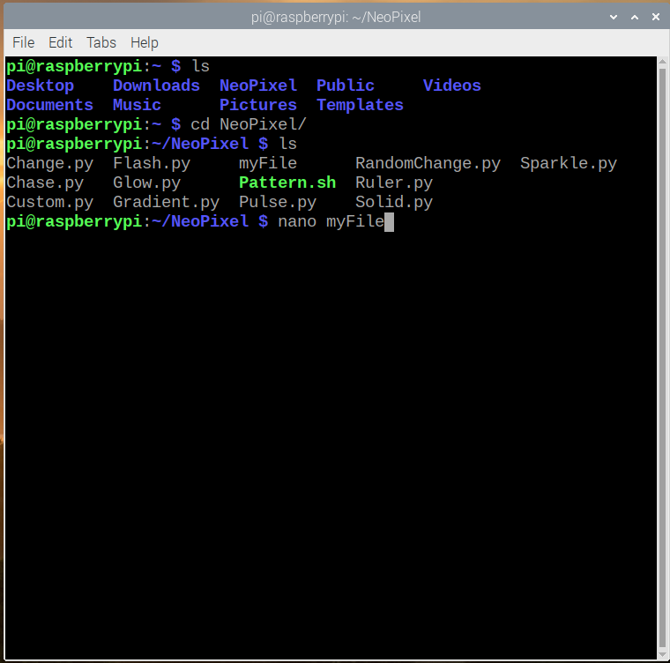
Opening files using Nano
Notes:
We’re going to use a command line text editor called nano to edit files in this course.
Almost everything will do will involve editing the text files that contain our code Here we create a new text file, called myFIle, and load it into the nano editor. Write the command nano, followed by the name of the file you want to create (call it myFile), to open a new file

Slide 8
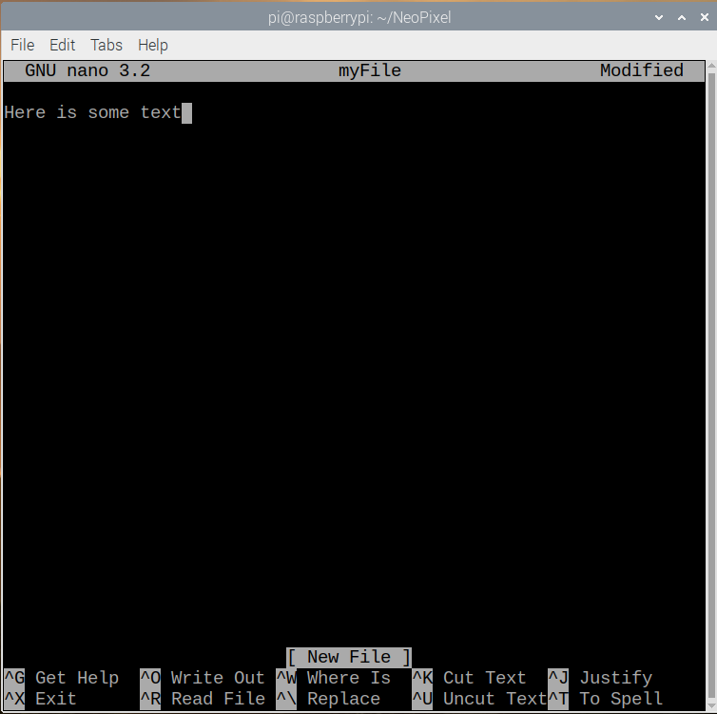
Editing files with nano
Notes:
Write a small amount of text into the file It really doesn’t matter what you write here, we’re just leaning the workflow and creating a text file.

Slide 9
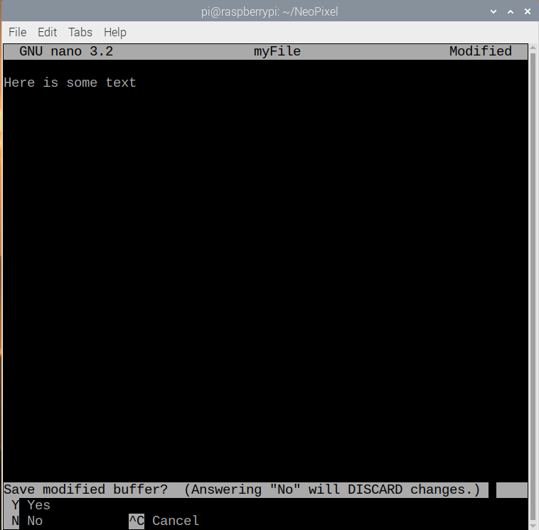
Saving files with nano
CTRL+X Y
Notes:
Exit nano by using the CTRL+X key Confirm that you want to save changes uses the y key. You can also select to not save changes with n or Cancel with CTRL+C

Slide 10
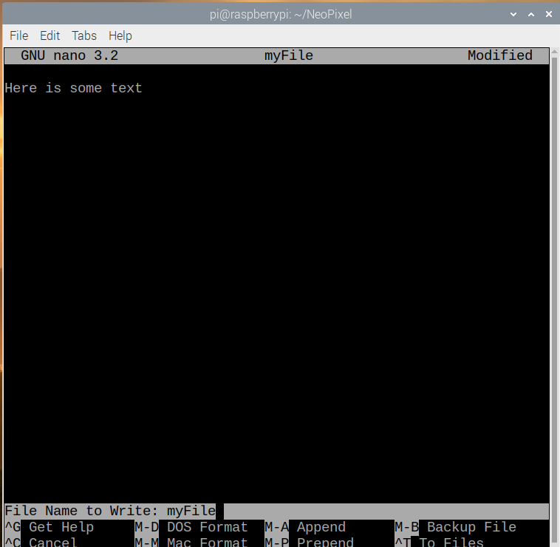
Saving file with nano
enter
Notes:
You can change the name of the file if needed, but for now just press enter since this name is correct.

Slide 11
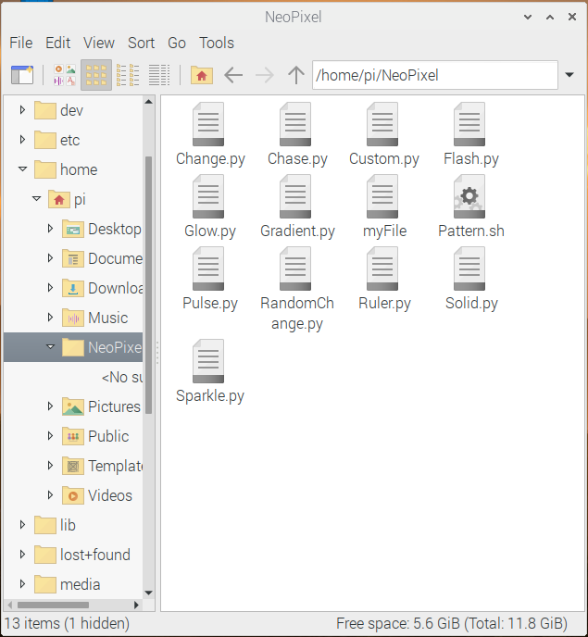
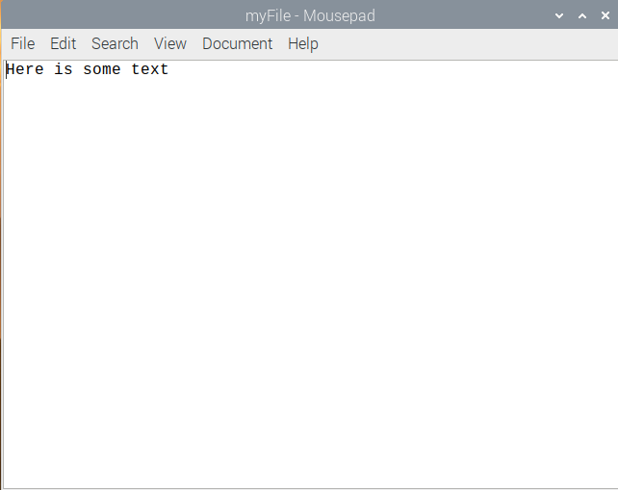
Opening files with Gedit
Notes:
You can see that a new file has been created in the NeoPixel directory. You can open this file with the default text editor, called gedit, if you’d like. CLICK You should see some familiar text inside. The purpose of this walk through has been to understand the process of creating and editing files from the command line, which may be new to you. Hopefully you see the parallels between doing it this way, and doing it the mousey-clicky GUI way that many people are more familiar with. You may close the text editor and file browser now, we will be using the command line for the remainder of this course. This means we edit and run python scripts from the same window. This workflow is great for working remotely via SSH, when the Raspberry Pi is not connected to a mouse and keyboard as we’ll see on day 4.

Slide 12
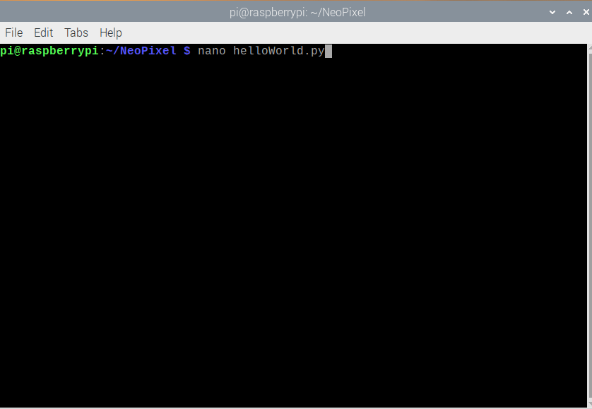
Python3 Hello World
Notes:
Just like we did before, create a new text file using nano.
This time we are going to call that file helloworld, and give it a file extension of .py.
This tells our OS that this file is going to contain python code.

Slide 13
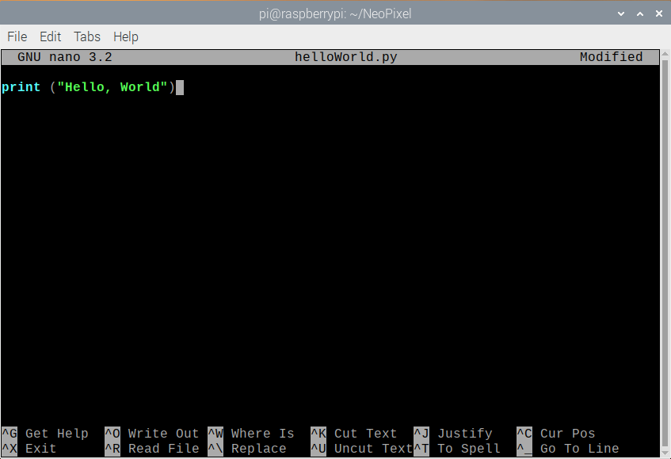
Python3 Hello World
CTRL+X Y
ENTER
Notes:
Write the text you see on screen into file. When you’ve finished exit with CTRL+X Y to save Enter

Slide 14

Python3 Hello World
Notes:
Run the program using python3 Note: we use python3 in this course, the most common version of python. But running the python command on Raspbian still defaults to the older python 2 by default. Type python3 and then pass the name of the python script to run. What do you see happen when the program runs?

Slide 15
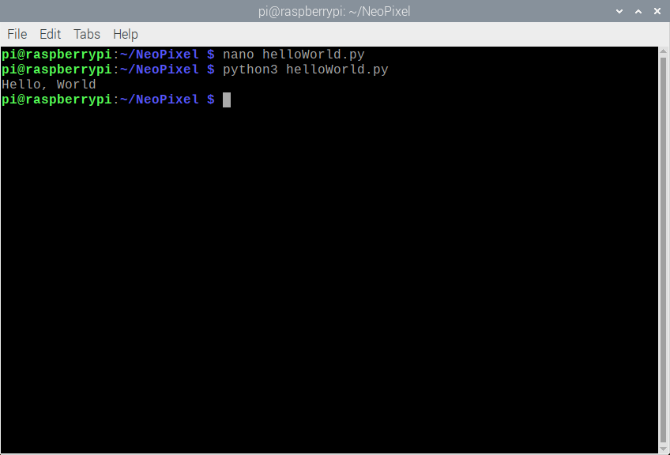
Python3 Hello World
Notes:
This is what the results should look like. It may not seem like much, but we’ve done a lot here to show that we’re ready to do python development on this computer. We’ve shown python can run. We’ve shown it can take a script that we’ve written. We’ve shown we can get debugging information (print statements) to the output of that window. We’re ready to write python code.

Slide 16
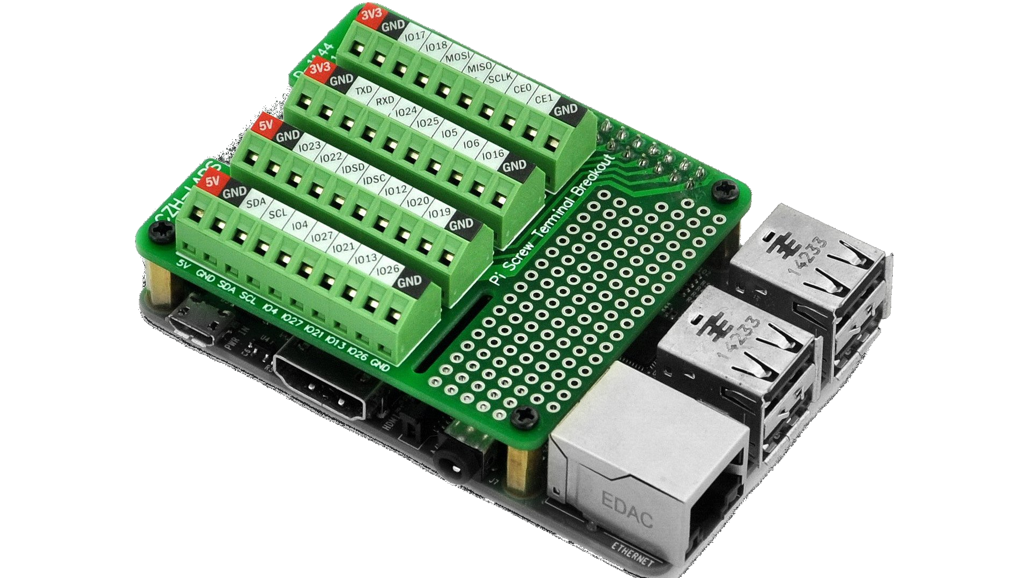
Connecting the Screw Terminal Hat
2 - Slide GPIO female headers over RPi GPIO male header pins
1 - Connect Standoffs to Raspberry Pi, screw in from the bottom
3 - Insert screws to securely mount hat to RPi
Notes:
The screw terminal hat gives us a secure electrical connection to devices connected by wires. The standoffs help keep the screw terminal hat secured in place. Put into position and screw them into place from the bottom. Put the board in place, sliding the female header pins over the male headers on the Raspberry Pi. Put screws in from the top to secure everything in place.

Slide 17
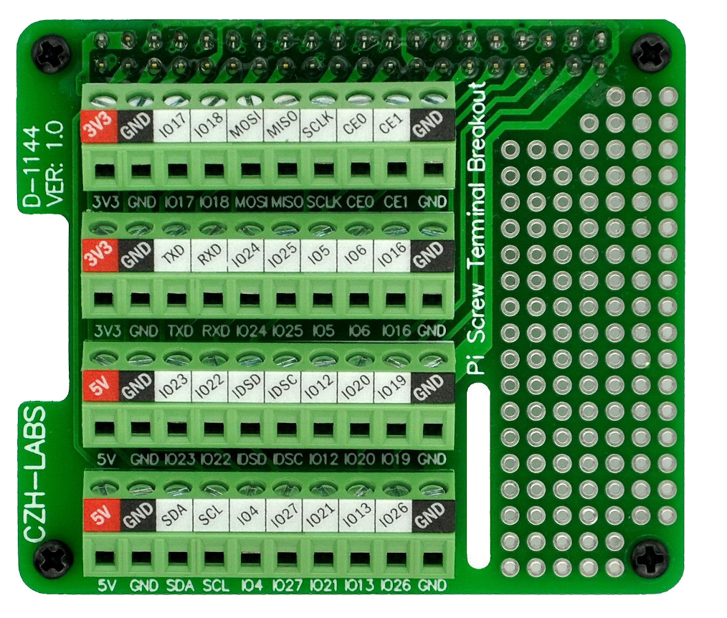
Connecting the NeoPixel Strip
Connect Data Wire (green) to pin IO18
Connect power wire (Red) to 5V pin
Connect ground wire (white) to GND pin
Notes:
Put the stripped wire into the hole at the bottom of the terminal and turn the screw clockwise until it’s tight and the wire cannot be easily pulled out. Connect all three wires coming out of the NeoPixel strand to the indicated pins.

Slide 18

NeoPixel Test Script
CTRL+C
Notes:
Run the included program Test.py using python3. Run the program using the magic word ‘sudo’ in front of python3, this makes it run with full permissions as the root user. If you see a chasing light, you know that everything is working, and you are ready to start writing your own NeoPixel code in the next class. This program will run forever until you kill it with the keyboard command CTRL+C

Slide 19
End Setup

